Slide 1
COMPANY OVERVIEW
ABC Computers
PREPARED BY ARIF
BATCH-41
DATE: 07-12-2024
V

Slide 2
EXECUTIVE SUMMARY
RAYANS Computers the leading computer store chain in Bangladesh, offering a wide range of products and services. They specialize in laptops, desktops, tablets, cameras, and computer accessories. RAYANS Computers boasts a strong presence with physical stores and a user-friendly website for online purchases.

Slide 3
PRODUCTS AND SERVICES
Product:
Laptops,
Desktops,
Tablets,
Cameras,
PC
Components,
Software Office Equipment, etc
Services
After-sales support,
product-related services (details not publicly available).

Slide 4
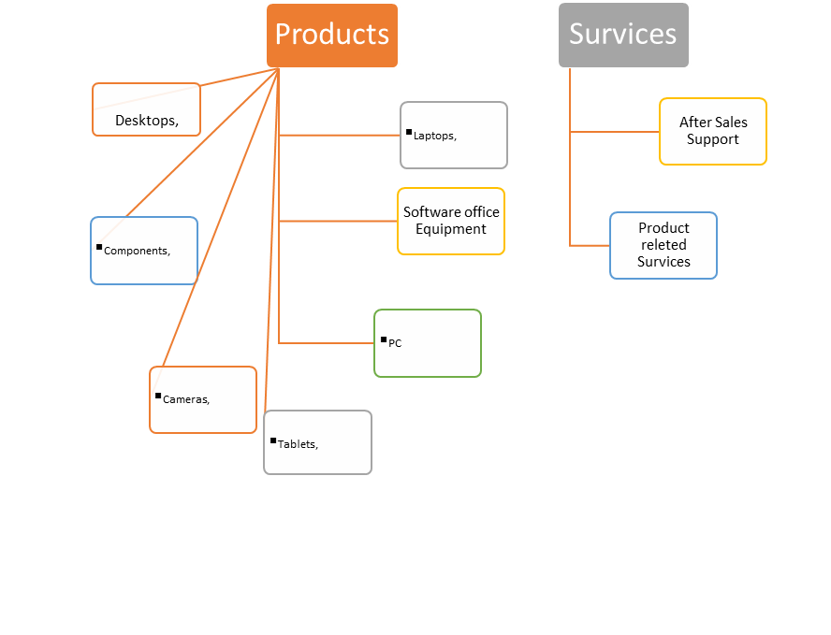
PRODUCTS AND SERVICES

Slide 5
BUSINESS PLAN
Business Plan
Focus on Customer customer Satisfaction
Large Product Range
Strong Online Presence

Slide 6
SALES AND COST STATISTICS:
Regional Sales:
Region | Sales
Barishal | 5010000
Chittagong | 4340000
Dhaka | 5850000
Sylhet | 4600000
Rajshahi | 4760000
Khulna | 4110000

Slide 7
3 Months Statistics:
Month | Expenses | Sales | Retail Profit | Profit/Loss
January | 7854500 | 8750000 | 895500 | Profit
February | 9998300 | 9920000 | -78300 | Loss
march | 8985700 | 10000000 | 1014300 | Profit

Slide 8
Sales Statistics:

Slide 9
Conclusion
Rayans Computer IS Doing Very Good
We Need To Focus on Customer Satisfaction
We Need to Best Practise of Our Service

Slide 10
Thank You

